Slide 1
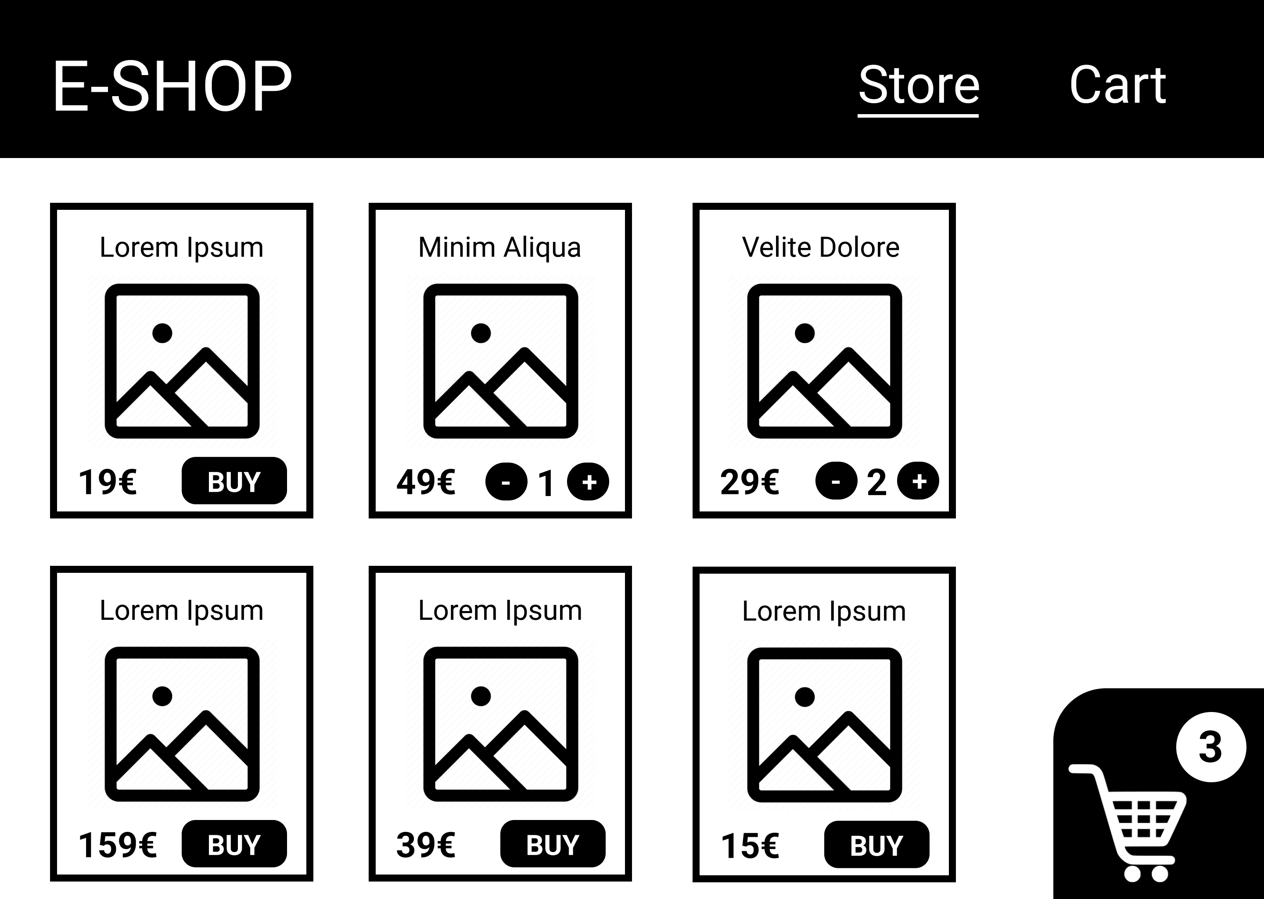
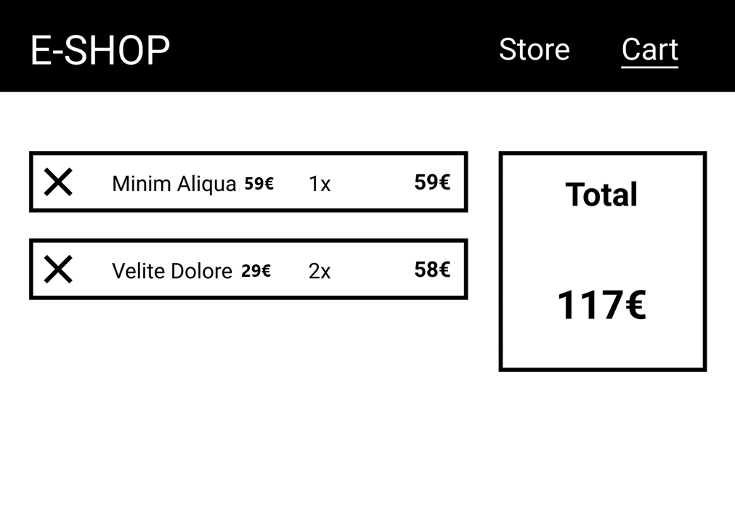
Task
Create a frontend e-shop similar to the one on the provided images
Use Vue 3, preferably with composition api, Vue Router and Pinia
Single page app with two routes – Store (/store) and Cart (/cart)
To switch between the routes, you can also use links in the header
Current route is indicated by an underline

Slide 2
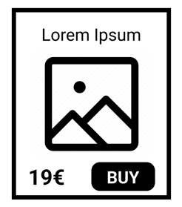
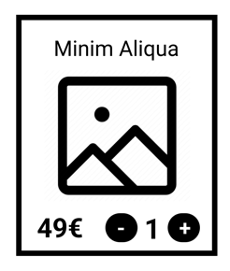

Store Page
Use the provided JSON file for shop items.
Each item has a BUY button that will add an item to the cart.
The BUY button will change into a quantity input once the item has been added to the cart.
A cart icon in the bottom right corner indicates the current number of items in the cart.

Slide 3
Cart Page
List of all items that are currently in the cart with their quantity and price
Each item can be removed from the cart using the ✕ button.
A total sum of item prices is displayed on the right.

